Slide 1

Energy Drink Consumption Among Students
Analyzing and Comparing Two Scientific Studies
Rozeta Makram 321
Mohammad Elfayez 521

Slide 2
Introduction
What is Energy drink consumption?
Energy drinks are beverages that contain caffeine, sugar, and other stimulants aimed at boosting alertness and energy levels.
Widely consumed by students for improved concentration and academic performance.
Why Study energy drink consumption?
Concerns about health risks associated with excessive energy drink intake, especially among students
.Understanding consumption patterns can help develop better public health strategies.
Objective of the Review:
Compare two studies to analyze the prevalence, motivations, and health effects of energy drink consumption among students,Whether there is a link between Energy drink consumption and better performance.

Slide 3


Who here consumes energy drink ?
Whats your opinion on medical students consuming energy drinks?
WHAT DO YOU KNOW ABOUT ITS SIDE EFFECTS ?

Slide 4
Mechanism of action
• Caffeine Blockade: Inhibits adenosine receptors, reducing fatigue and increasing alertness.
• Sympathetic Activation: Boosts catecholamine release (e.g., adrenaline), elevating heart rate and blood pressure.
• Rapid Energy Supply: High sugar content provides quick glucose for immediate energy.
• Taurine Effects: May modulate neurotransmission and support cardiovascular function.
• B-Vitamins Role: Aid in cellular energy metabolism

Slide 5
Overview of Selected Articles
Article 1: Energy Drink Consumption Among Medical Students
Published in: Annals of Medicine and Surgery (2024)
Focus: Examines the prevalence and reasons for energy drink consumption among medical students.
Article 2: Energy Drink Consumption and Academic Performance
Published in: International Journal of Medical Students (2023)
Focus: Investigates the impact of energy drink consumption on students' academic performance and health.

Slide 6
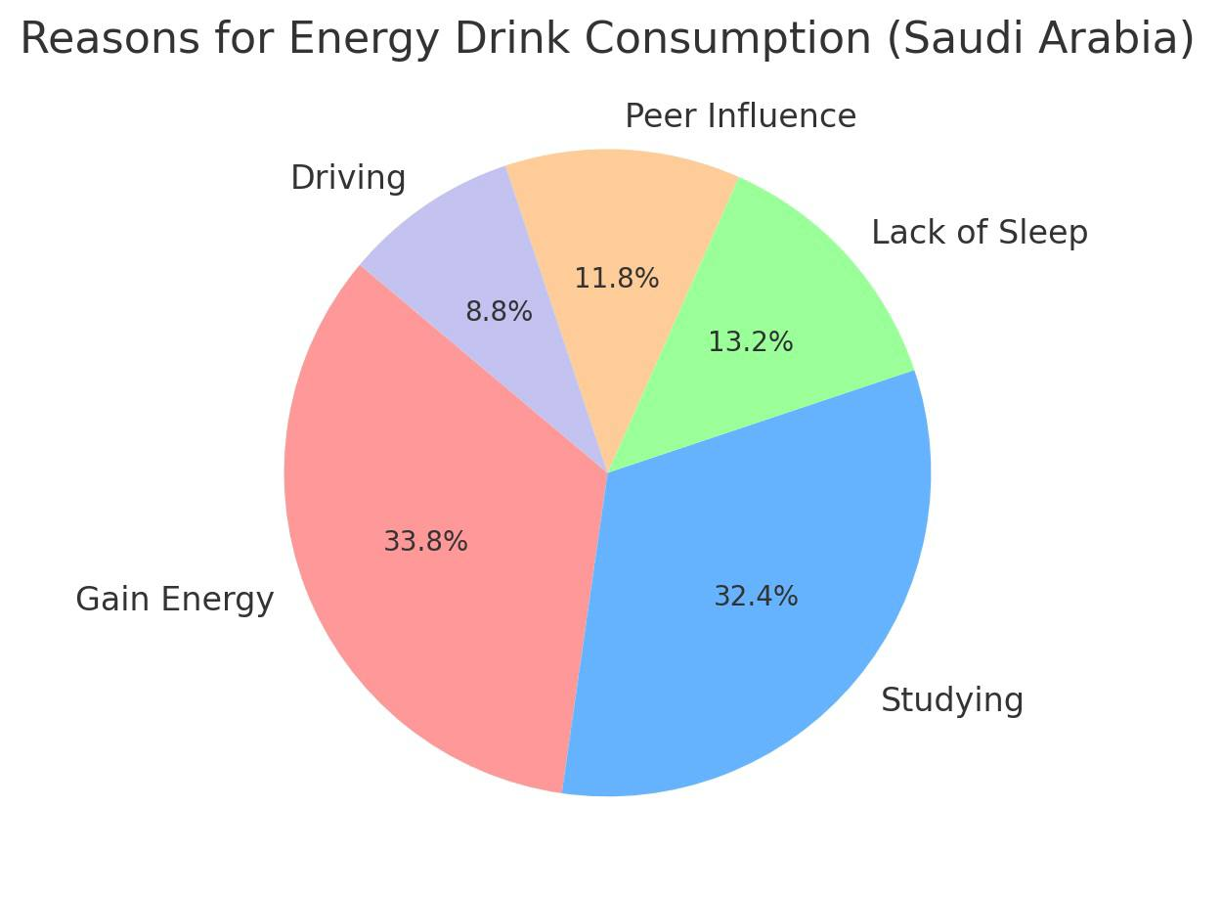
Article 1 - Key Elements
Type of Study: Observational (Survey-based study)
Sample Size: 257 medical students.
Population: students in government universities in Riyadh, Saudi Arabia
Variables:
Independent: Frequency and reasons for energy drink consumption.
Dependent: Reported effects on concentration, fatigue, and perceived benefits.
Hypothesis: Medical students consume energy drinks primarily for academic performance enhancement.
Results:
60% of students reported regular energy drink consumption.
Primary reasons included increased alertness (80%) and reduced fatigue (75%).
40% experienced side effects such as palpitations and sleep disturbances.

Slide 7
Article 2 - Key Elements
Type of Study: Cross-sectional study.
Sample Size: 307 university students.
Population: medical students from six public universities in Jordan.
Variables:
Independent: Energy drink consumption frequency and volume.
Dependent: Academic performance measured via GPA and reported health outcomes.
Hypothesis: Higher energy drink consumption negatively impacts academic performance and health.
Results:
45% of students consumed energy drinks at least once a week.
No significant correlation found between consumption and improved academic performance.
Increased consumption linked to sleep disturbances and anxiety.

Slide 8
Comparison of Studies
Aspect | Article 1 | Article 2
Type of Study | Observational (survey-based) | Observational (Cross-sectional study)
Sample Size | 257 | 307
Population | medical students from Umm Al-Qura University | medical students from six public universities in Jordan
Variables | Consumption patterns and motivations | Consumption vs academic performance
Results | High consumption for alertness,with side effects | No academic benefits,negative health effects

Slide 9
Key Insights
Similarities:
Both studies highlight significant energy drink consumption among students.
Reported negative health effects like sleep disturbances and anxiety.
Differences:
Article 1 focuses on reasons for consumption, particularly among medical students.
Article 2 examines the academic impact of energy drink consumption.
Article 1 suggests students believe energy drinks help academically, while Article 2 finds no actual academic improvement.

Slide 10
Implications for the field of Medicine
Health Concerns:
Excessive caffeine intake may lead to cardiovascular issues and dependence.
Education on moderation and healthier alternatives is necessary.
Policy Recommendations:
Universities should raise awareness about potential health risks.
Stricter regulations on marketing energy drinks to students may be beneficial.
Future Research:
Longitudinal studies to determine long-term health impacts.
Broader demographic studies to generalize findings beyond university students.

Slide 11
Conclusion
Summary:
Energy drink consumption is common among students, primarily for academic performance enhancement.
While students believe energy drinks help, there is no strong evidence linking them to better academic performance.
Negative health effects, such as sleep issues and anxiety, are widely reported.
Key Takeaway - Awareness campaigns and further research are necessary to guide responsible energy drink consumption among students.

Slide 12
References
Annals of Medicine and Surgery (2024). Energy Drink Consumption Among Medical Students. https://journals.lww.com/annals-of-medicine-and-surgery/toc/2024/04000
International Journal of Medical Students (2023). Energy Drink Consumption and Academic Performance. http://dx.doi.org/10.5195/ijms.2013.215

